Slide 1
Introduction to Deep Learning

Slide 2
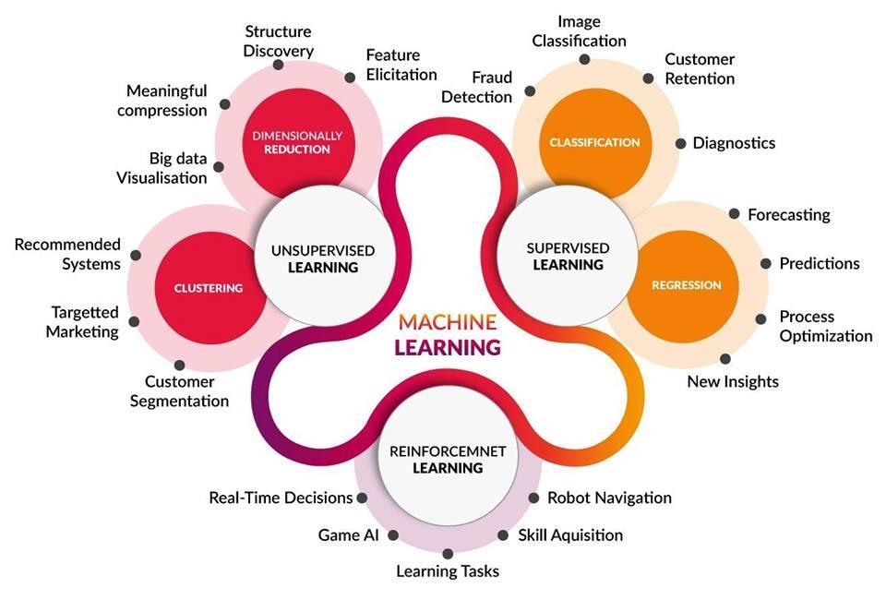
Notes:
An overview of different branches of machine learning

Slide 3
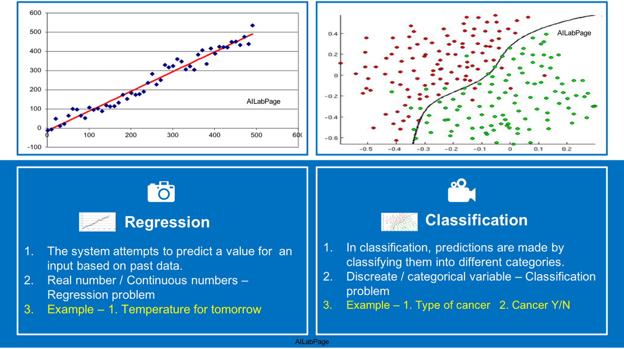
Supervised Learning
Source: https://vinodsblog.com/2018/11/08/classification-and-regression-demystified-in-machine-learning/

Slide 4
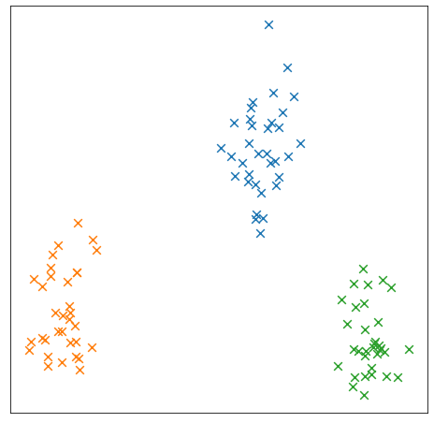
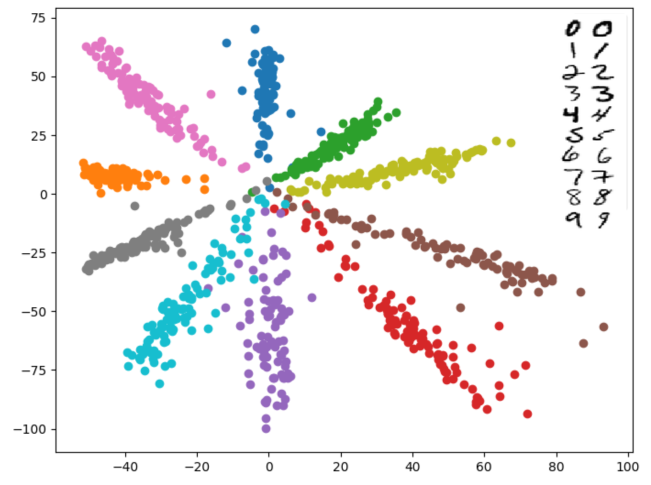
Unsupervised learning
Clustering
Dimensionality Reduction
Source: http://unixnme.blogspot.com/2018/04/dimensionality-reduction-and-scattered.html
Notes:
Clustering: putting data points into separate groups based on their similarity
Dimensionality Reduction: representing data in lower dimensions. Commonly for visualisation purposes.
Right image: 2-D representation of MNIST. 28x28 (784) → 2

Slide 5
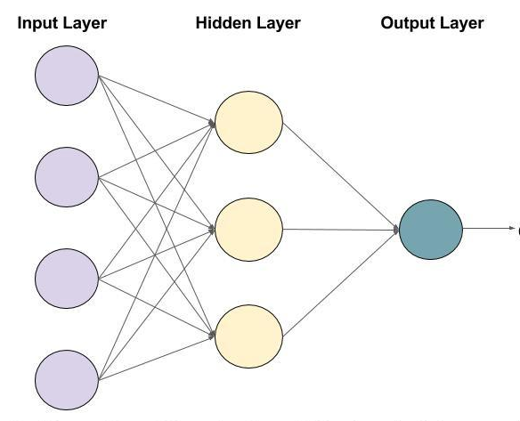
Artificial Neural Networks (ANN)
Inspired by biological neural networks.
The circles are called Neurons.
The arrows are called connections.
Each column of Neurons is called a layer.
Every Connection and Neuron represents a value.

Slide 6
Artificial Neural Networks (ANN)
The value in a Neuron is multiplied by the value of the Connection.
The output of all the connections that enter a Neuron is summed up.
An extra value (bias) is added to the summation.
The result is passed through an activation function.

Slide 7
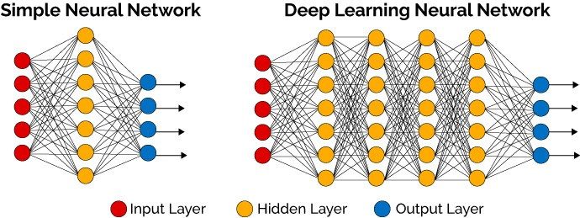
Deep Neural Networks (DNN)

Slide 8
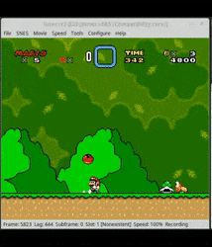
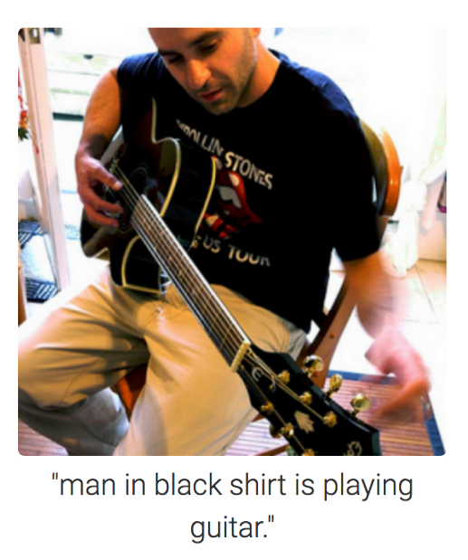
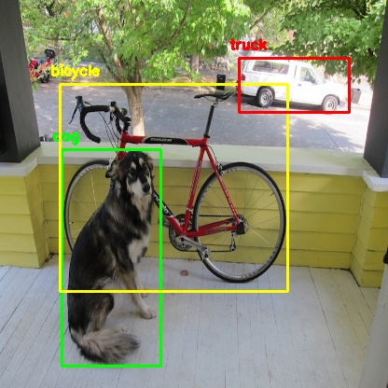
Applications
Tabular data
Computer Vision
Natural Language Processing
Time Series
Reinforcement Learning
Generative models

Slide 9
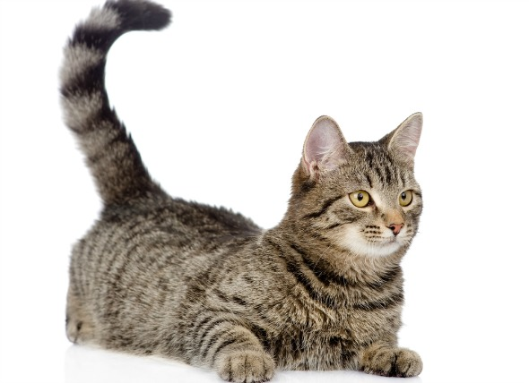
Computer Vision
We want to know the main subject in an image. How can a model do that?
This is one of the first computer vision problems.
Image Classification

Slide 10
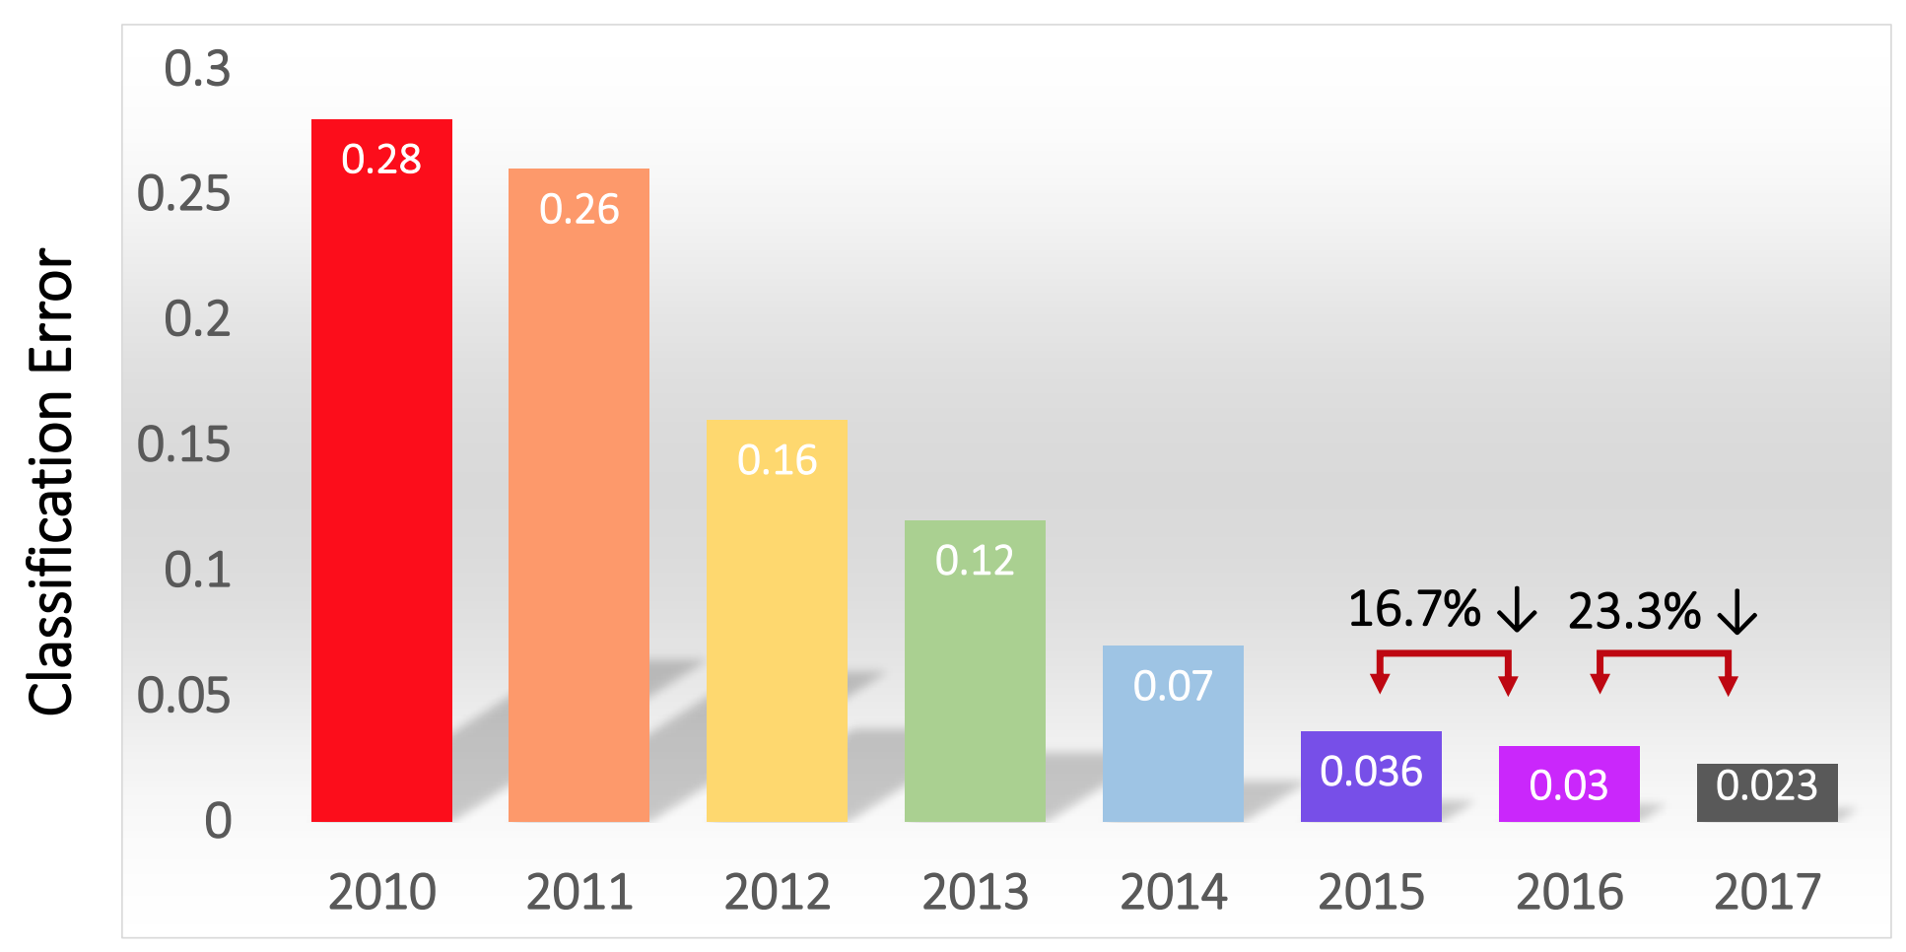
ImageNet Challenge
The goal is to successfully predict the object inside images. They used 1.4 million images of 1000 categories.
In 2012, a deep learning model called AlexNet won the competition.
In 2015, ResNet by Microsoft won the competition beating human performance.
Source: https://www.kaggle.com/getting-started/149448

Slide 11
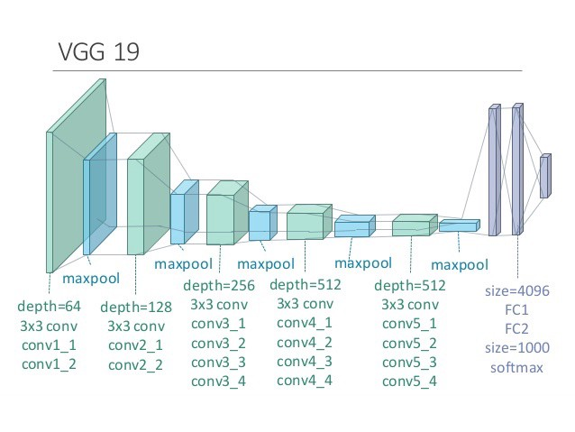
How does it work?
We have multi-layered (deep) neural network.
Each layer extracts specific features from the image.
The final layer uses the extracted features to decide what the main subject in the image is.
Source:https://www.researchgate.net/publication/325137356_Breast_cancer_screening_using_convolutional_neural_network_and_follow-up_digital_mammography

Slide 12
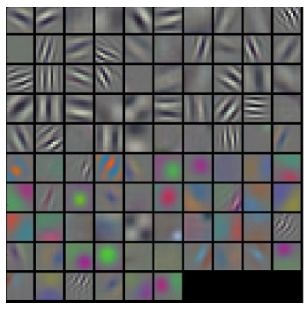
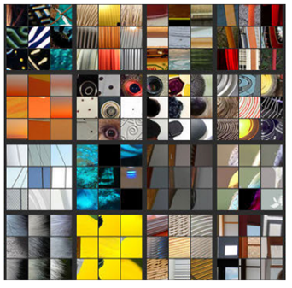
What are the features?
Source: https://arxiv.org/pdf/1311.2901v3.pdf
Notes:
Visualisation of Alexnet activations. Layers 1 & 2

Slide 13
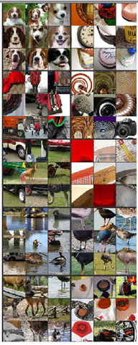
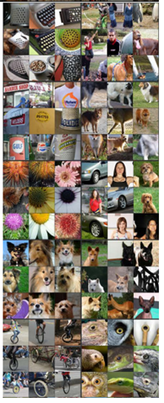
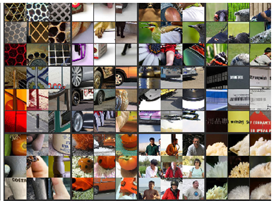
What are the features?
Source: https://arxiv.org/pdf/1311.2901v3.pdf
Notes:
Visualisation of Alexnet activations. Layers 3-5

Slide 14
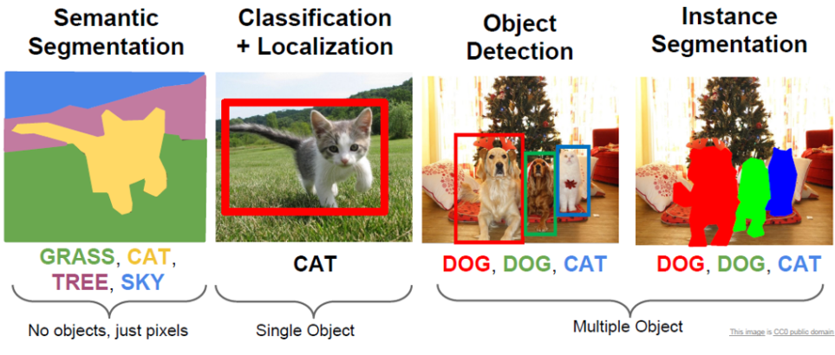
Computer Vision
Source: http://neohsu.com/2018/12/04/metrics-in-2d-computer-vision-binary-classification-object-detection-and-image-segmentation/
Notes:
Semantic Segmentation: Classifying pixels of an image
Classification + localisation: Classifying the main subject of the image and producing a bounding box to show where in the image it is located.
Object Detection: Finding multiple objects in an image and creating a bounding box for each.
Instance segmentation: Finding multiple objects and classifying their pixels simultaneously.

Slide 15

Semantic Segmentation
Classifying the pixels of an image
Common architecture:
U-net
Advantage:
High accuracy in location of the object
Disadvantage:
Can’t identify the number of objects
Source: https://towardsdatascience.com/unet-line-by-line-explanation-9b191c76baf5

Slide 16
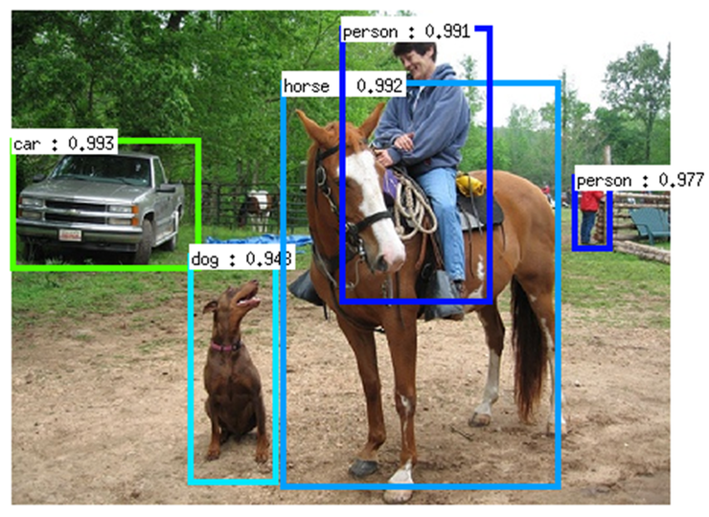
Object Detection
Locate and classify the objects and draw a bounding box around them.
Common Architectures:
SSD
Faster R-CNN
YOLO
Advantage:
Locate the object
Can detect multiple objects of the same type
Disadvantage:
Does not have pixel-level classification
Source: https://dius.com.au/2016/12/06/the-cleverness-of-deep-learning/

Slide 17
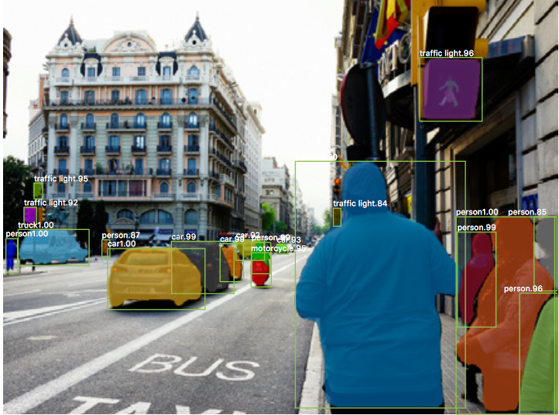
Instance Segmentation
Locates and classifies every instance of an object and creates a pixel-level classification mask
Common Architecture:
Mask R-CNN
Advantage:
Can identify multiple objects of the same class
Does pixel classification for each instance
Disadvantage:
Slow in training and inference
Source: https://medium.com/hackernoon/up-to-speed-on-deep-learning-may-update-a146d851f14f

Slide 18
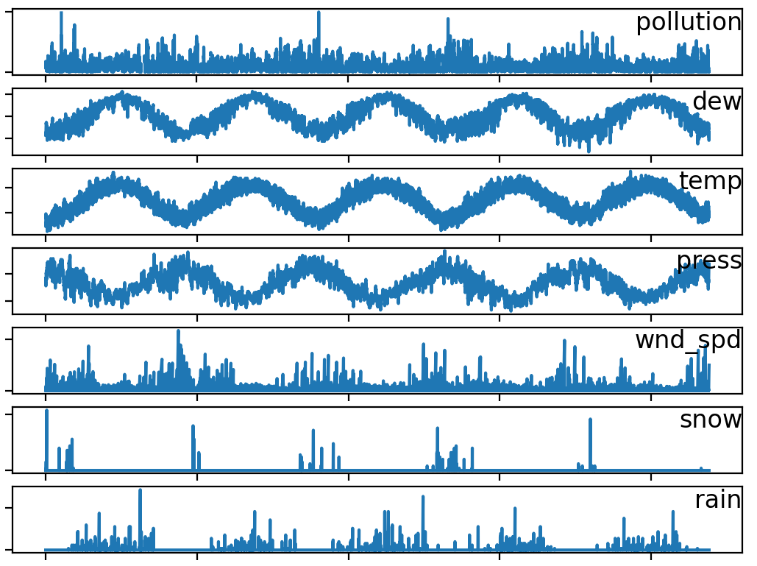
Time Series
Economic Forecasting
What’s the inflation rate next year?
Weather Forecasting
What’s the probability of tomorrow raining?
Inventory Analysis
How much of this item do I need to stock?
Sales Forecasting
What is the sales going to be like next week?
Anything that changes with time
Source: https://machinelearningmastery.com/multivariate-time-series-forecasting-lstms-keras/

Slide 19

Natural Language Processing (NLP)
Sentiment Analysis
Is this review good or bad?
Topic Segmentation
What is the topic of this article?
Machine Translation
Translating from one language to another
Question Answering
Chatbots
Text Summarisation
Text Similarity
Checking for plagiarism
Source: https://www.hitechnectar.com/blogs/natural-language-processing-nlp-chatbots/

Slide 20
Natural Language Processing
“A winter’s day when beams of sun are few,
And skies are grey with clouds intemperate,
Is to thy beauty somehow sordid grown.
Her lovely-lovely eye is quite shut up,
Like windows pale before a sunny shower.”
OpenAI GPT-3
Source: https://machinelearningknowledge.ai/openai-gpt-3-demos-to-convince-you-that-ai-threat-is-real-or-is-it/
Notes:
This poem is generated by GPT-3 to imitate Shakespeare

Slide 21
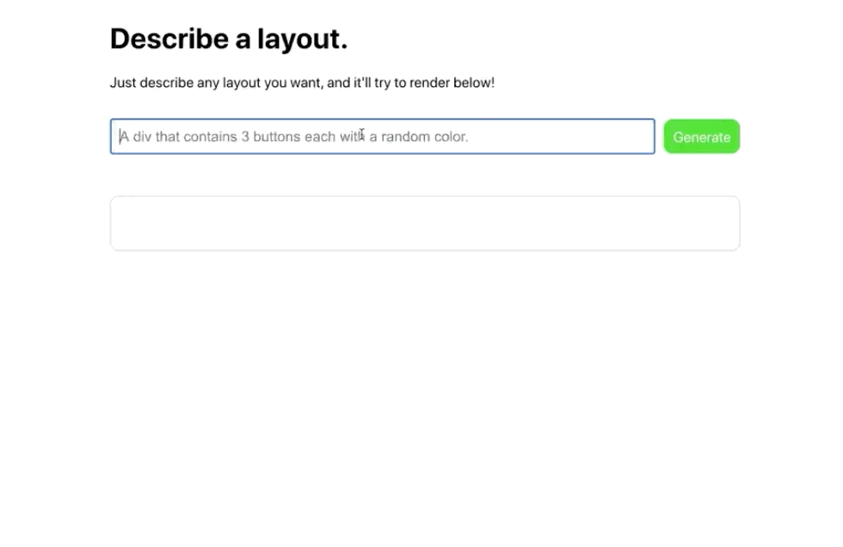
OpenAI GPT3
GPT3 has shown incredible abilities:
Generate text
Perform simple math from text
Generate code from description
Generate graphs from description

Slide 22

Reinforcement Learning
It’s neither Supervised nor Unsupervised learning
Agent learns by interacting with the environment.
It gets rewarded when the goal is achieved.
The agent learns by experience.
Source: https://en.wikipedia.org/wiki/Reinforcement_learning

Slide 23
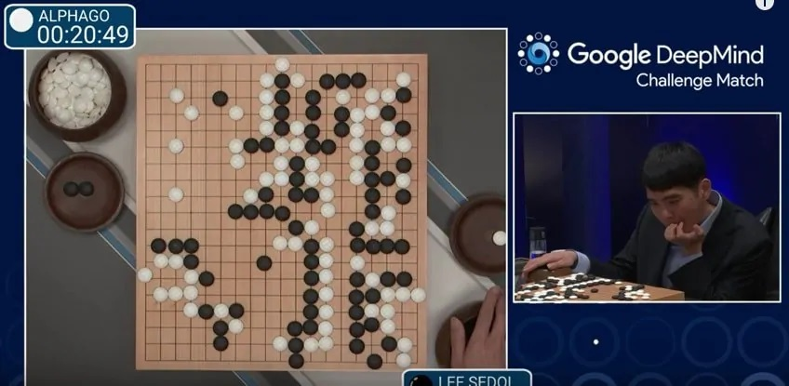
Reinforcement Learning – AlphaGo
The game of Go is 2×10¹²³ times more complex than chess
It was the first computer program to defeat a human Go master.
Used Monte Carlo Tree Search and deep neural network.
Its successor, AlphaGo Zero, learned the game of Go by playing against itself.
AlphaGo Zero became even better than AlphaGo
Source: https://sigmoidal.io/alphago-how-it-uses-reinforcement-learning-to-beat-go-masters/

Slide 24
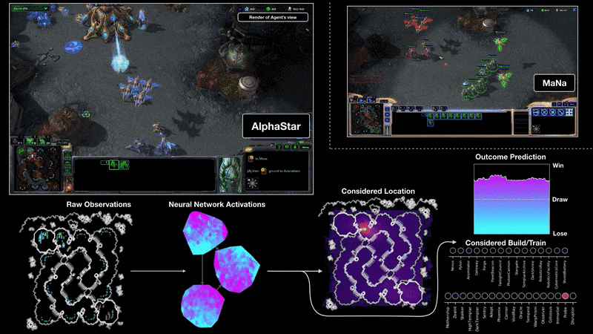
Reinforcement Learning - AlphaStar
Learned to play StarCraft II.
Unlike Go, it required real-time decision making
It could only see parts of the map.
It defeated a top professional StarCraft player
Source: https://deepmind.com/blog/article/alphastar-mastering-real-time-strategy-game-starcraft-ii

Slide 25
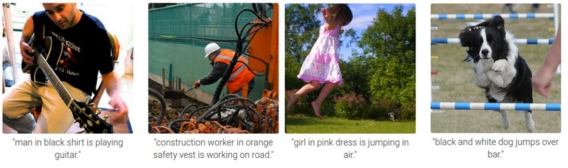
Image Captioning
Source: https://daniel.lasiman.com/post/image-captioning/
Notes:
Combining computer vision and natural language processing. This type of model can map the content of the image to a latent space which can be used by a language model to be converted to a caption.

Slide 26
Generative Adversarial Networks (GAN)
It has two main components:
Generator
Discriminator
Generator creates an item (photo, text, audio).
Discriminator tries to tell whether the item it receives is fake (generated).
Source: https://www.kdnuggets.com/2017/01/generative-adversarial-networks-hot-topic-machine-learning.html
Notes:
The generator learns the distribution of latent space representation of data, and how it is mapped to the actual data.

Slide 27
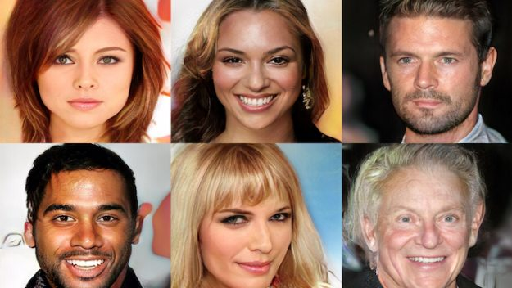
StyleGAN
Source: https://medium.com/@kcimc/how-to-recognize-fake-ai-generated-images-4d1f6f9a2842
Notes:
StyleGAN has the ability to generate new faces.

Slide 28
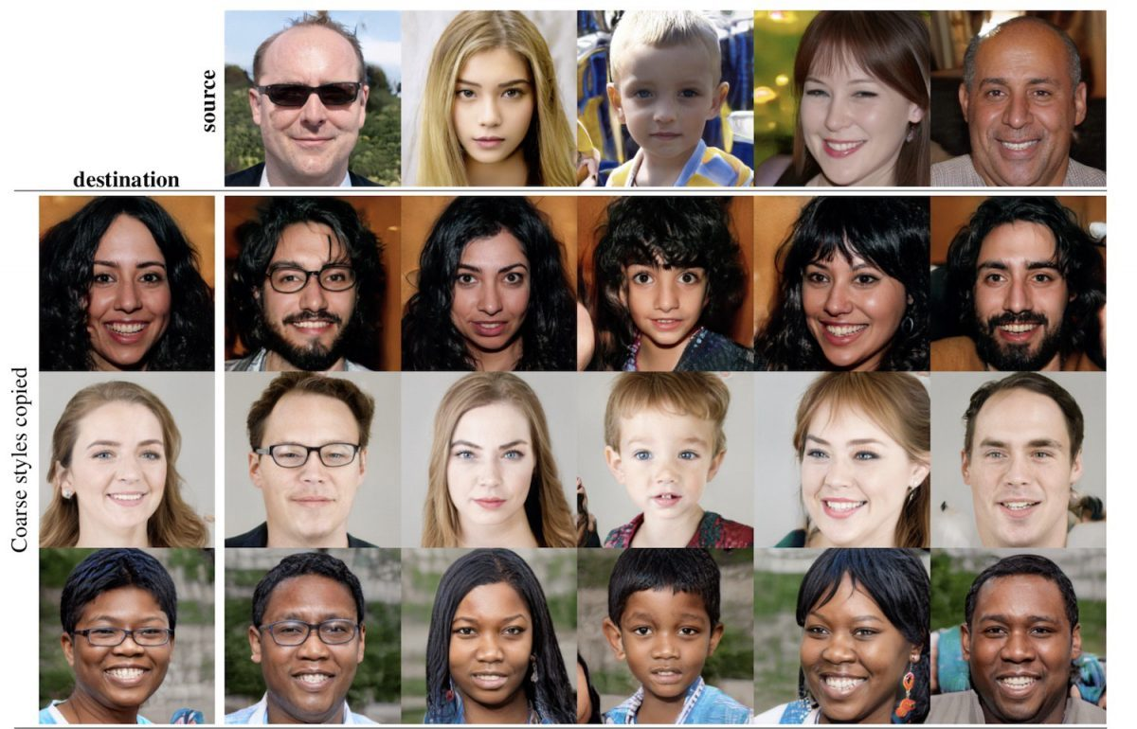
StyleGAN
Source: https://venturebeat.com/2019/12/26/gan-generative-adversarial-network-explainer-ai-machine-learning/
Notes:
It can also combine features from different faces.

Slide 29
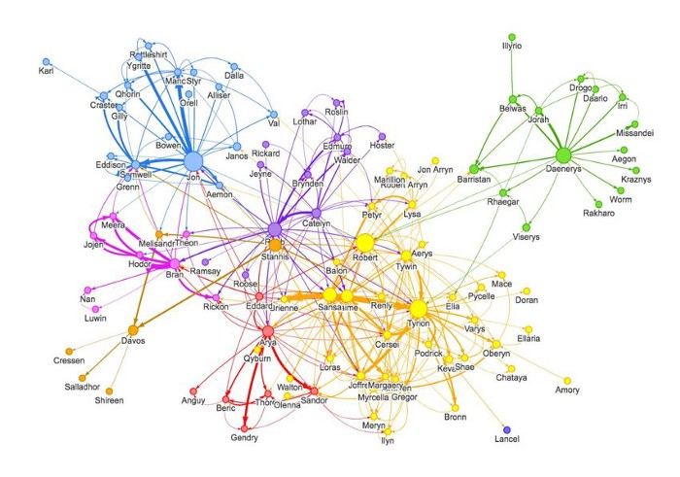
Graph Neural Netwrok
Not all data can be fit in a table or a grid.
GNN can work with non-Euclidean data such as graph structures.
The data consist of nodes and edges.
Nodes contain features of each data point.
Edges contain relationship between data points.
Source: https://medium.com/dair-ai/an-illustrated-guide-to-graph-neural-networks-d5564a551783

Slide 30
And many other applications
Pattern matching
Image colourisation
Pixel restoration
Pose estimation
Face detection and recognition
Language translation
Anomaly detection
And more …

